Slide 1
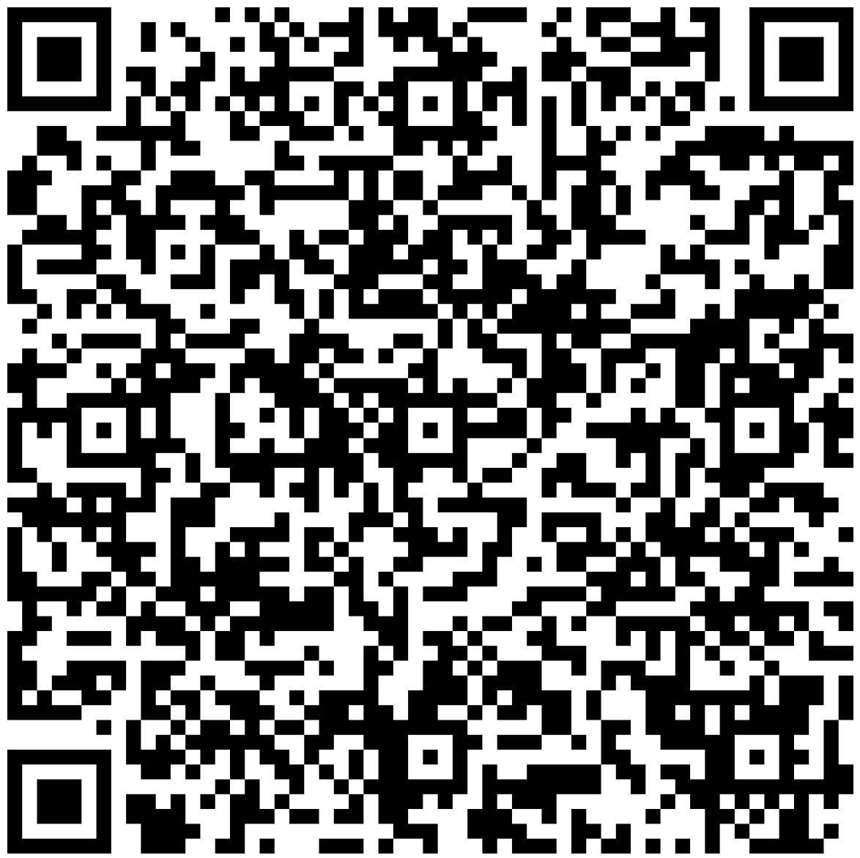

Slide 2
Bird/Wildlife Aircraft Strike Hazard
History
Arkansas Cases
Information

Slide 3
History
The first bird strike occurred in 1905
10,000 reports of bird and wildlife strikes each year
It is estimated that only 50% of strikes are reported
Over 293 people have lost their life due to wildlife strikes since 1988
Over 96% of wildlife strikes involve birds

Slide 4
Quiz!
How many bird strikes have been reported in Arkansas since January of 2020?

Slide 5
604

Slide 6
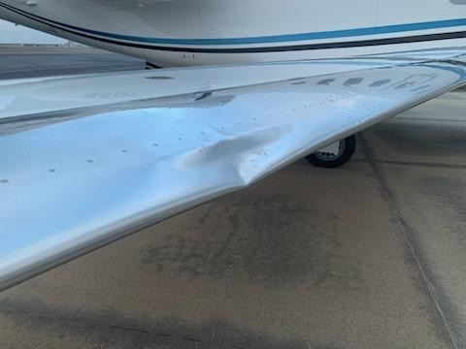

Slide 7
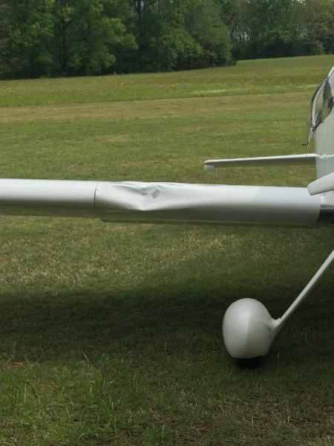

Slide 8
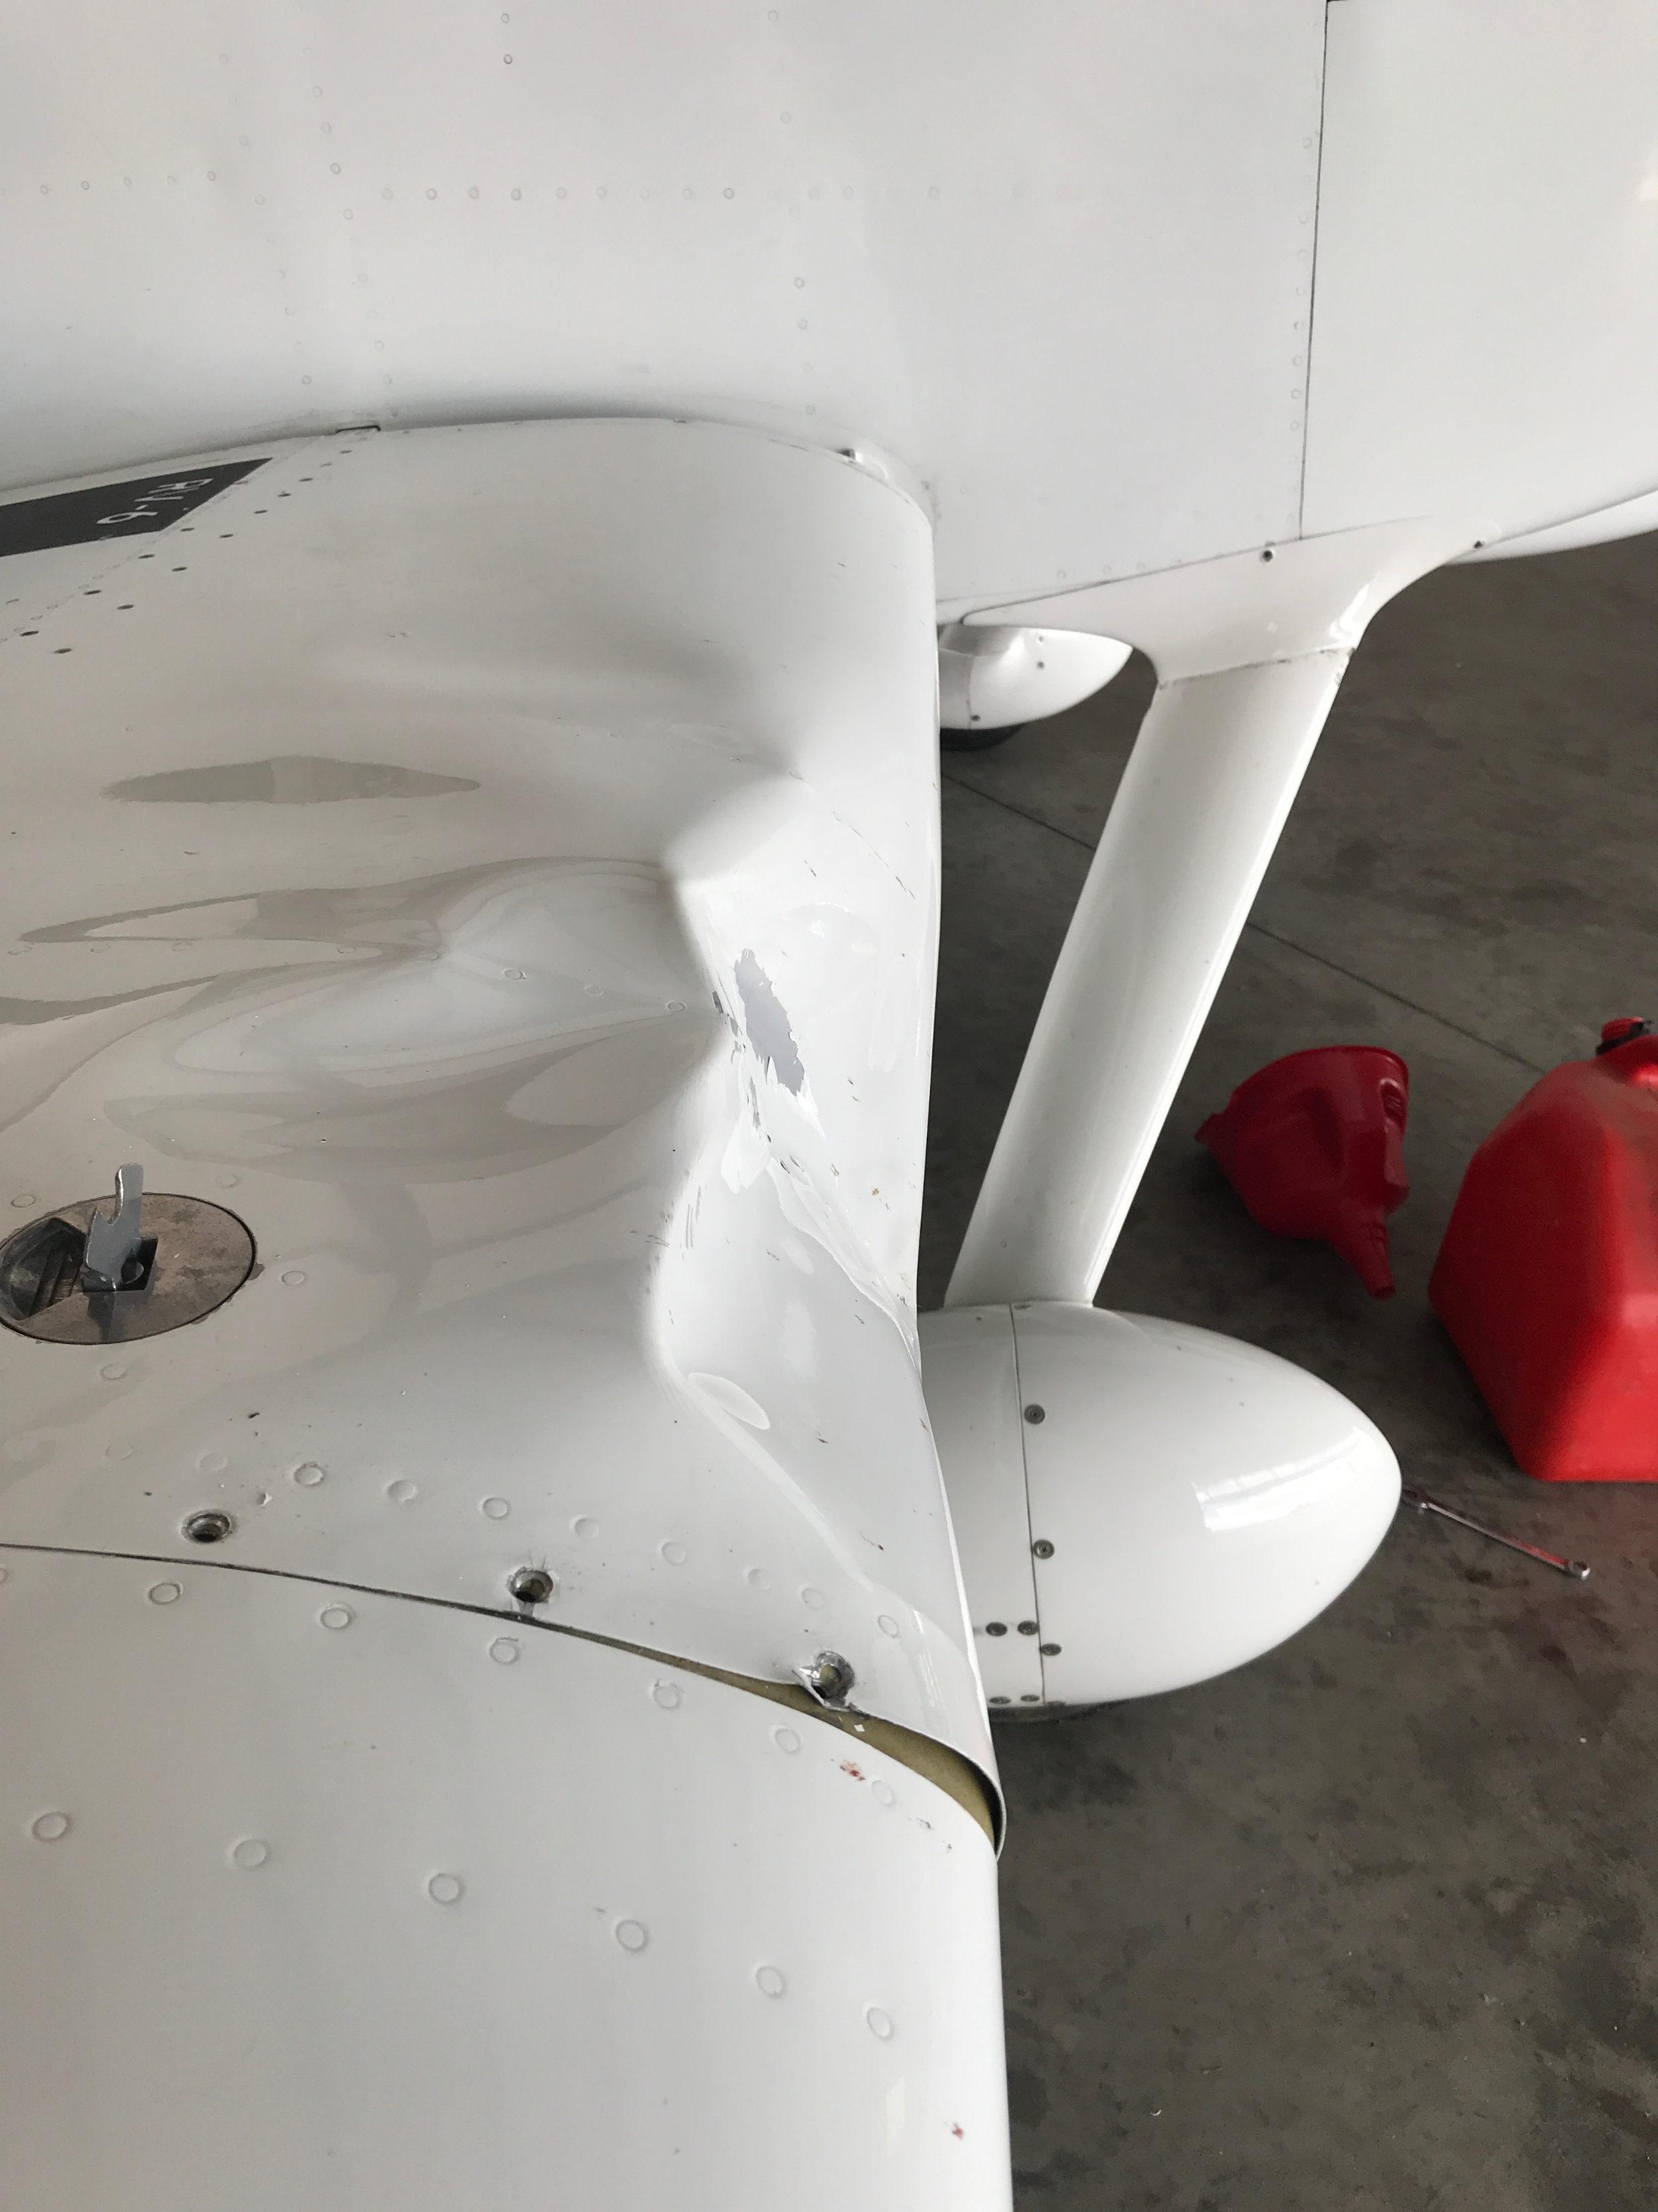

Slide 9
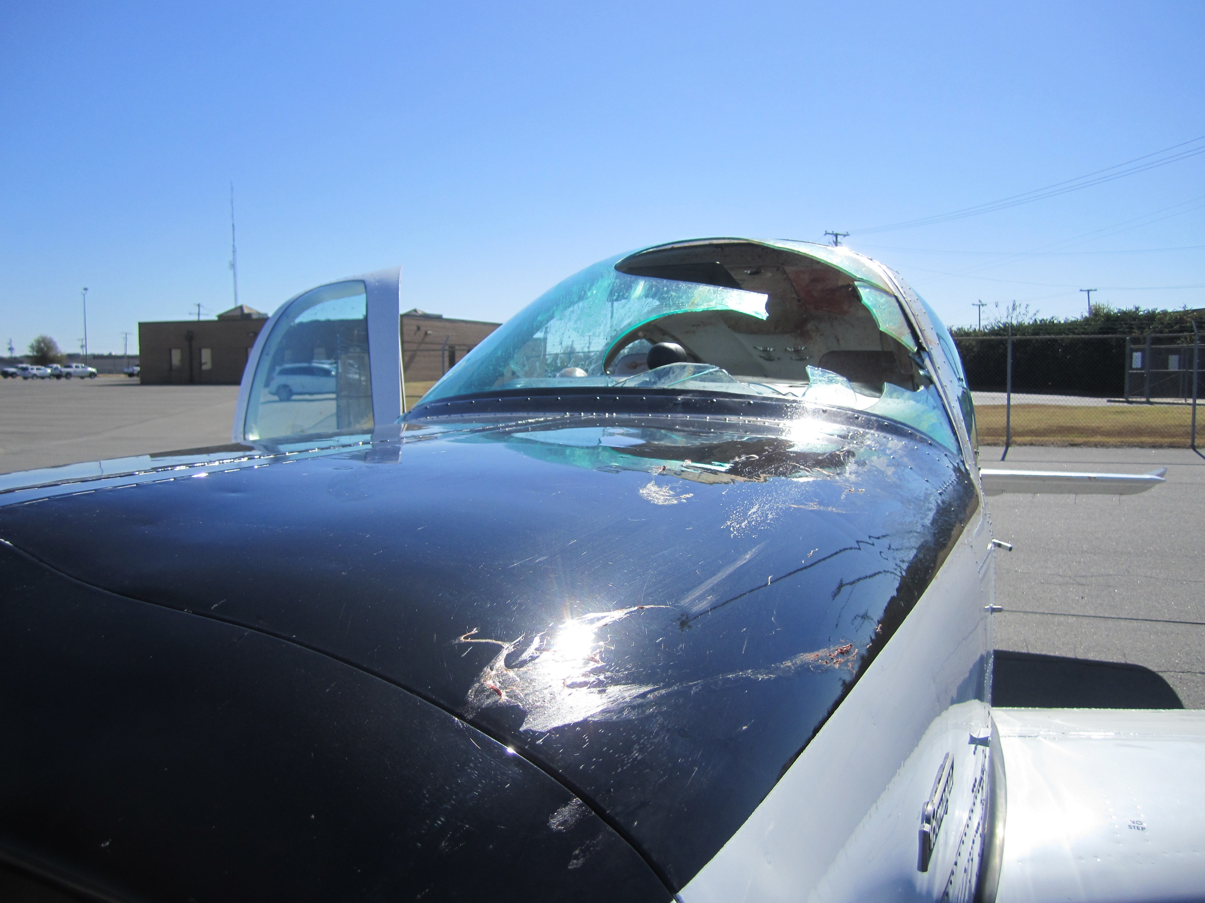

Slide 10
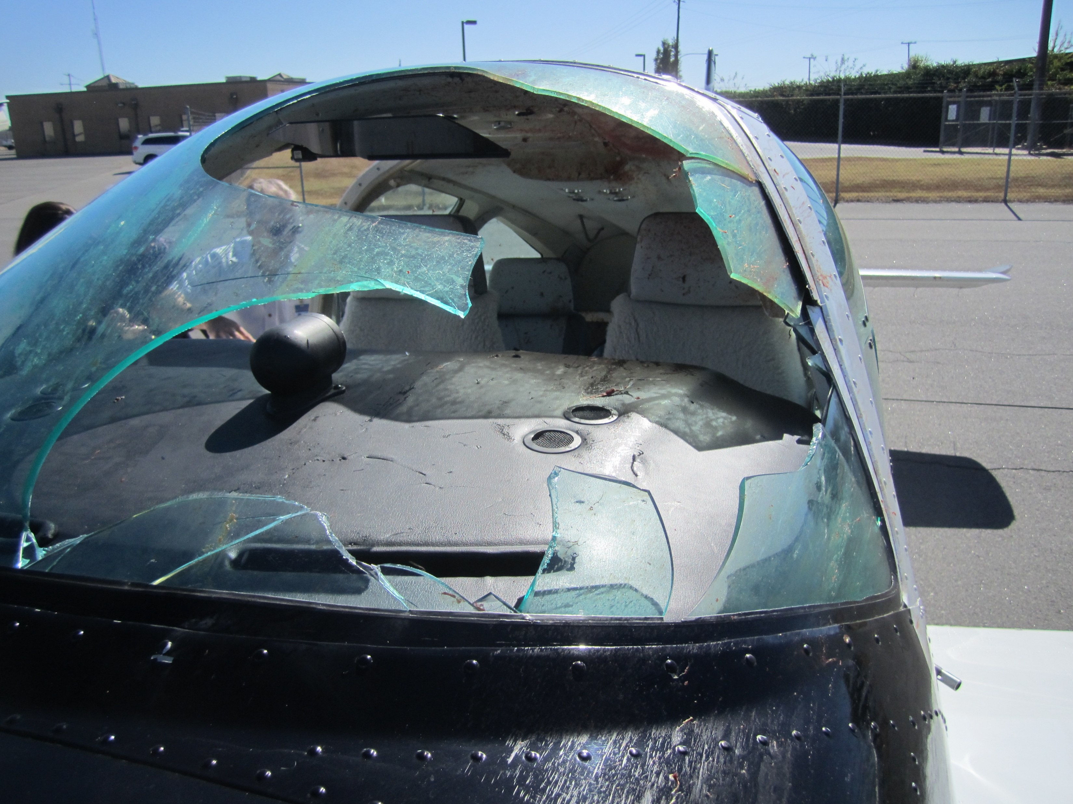

Slide 11
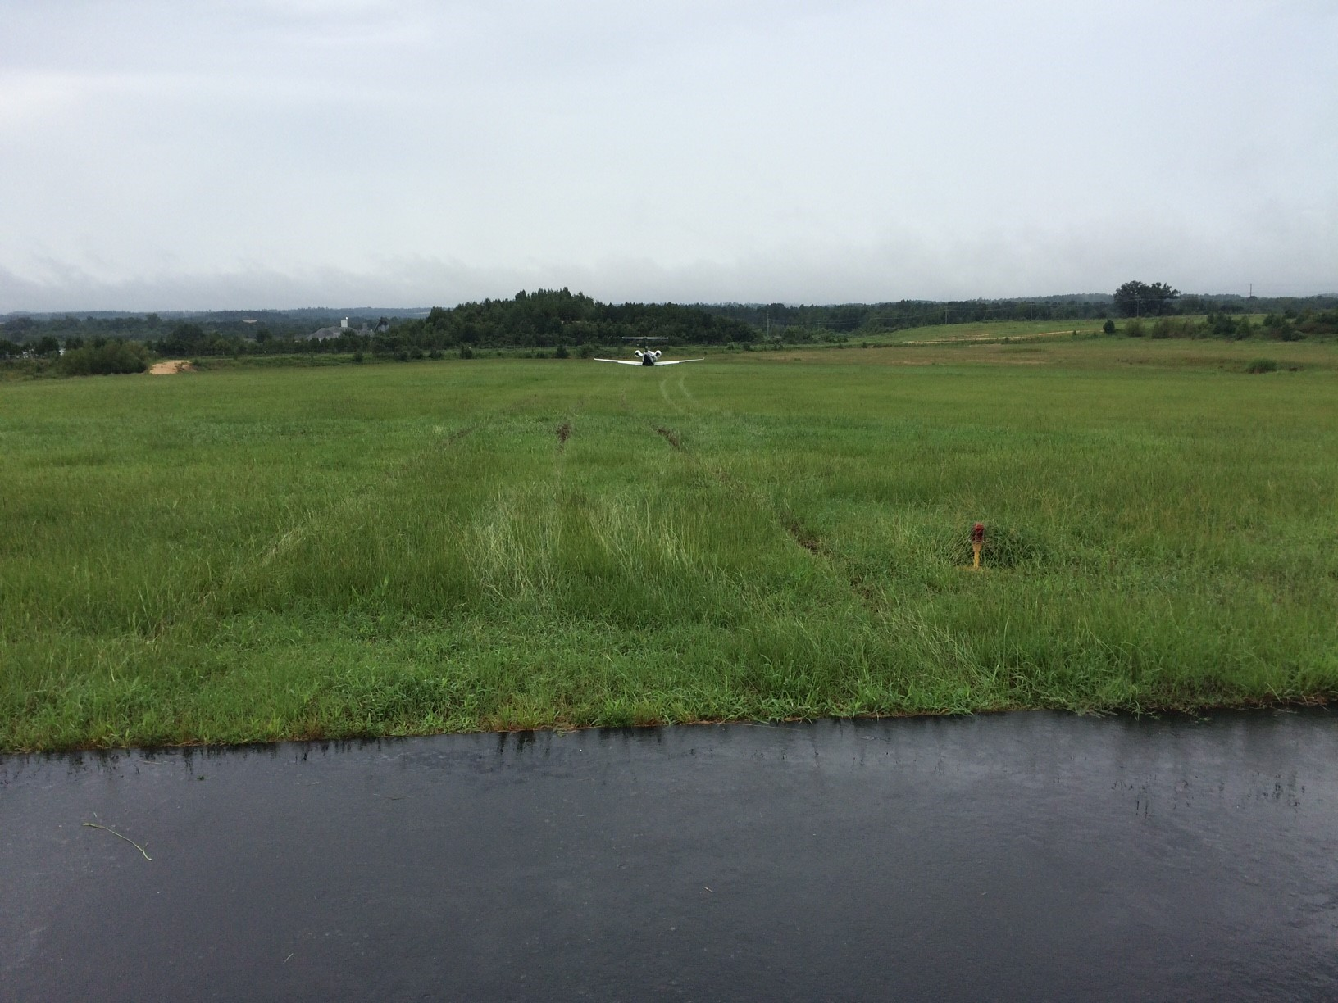

Slide 12
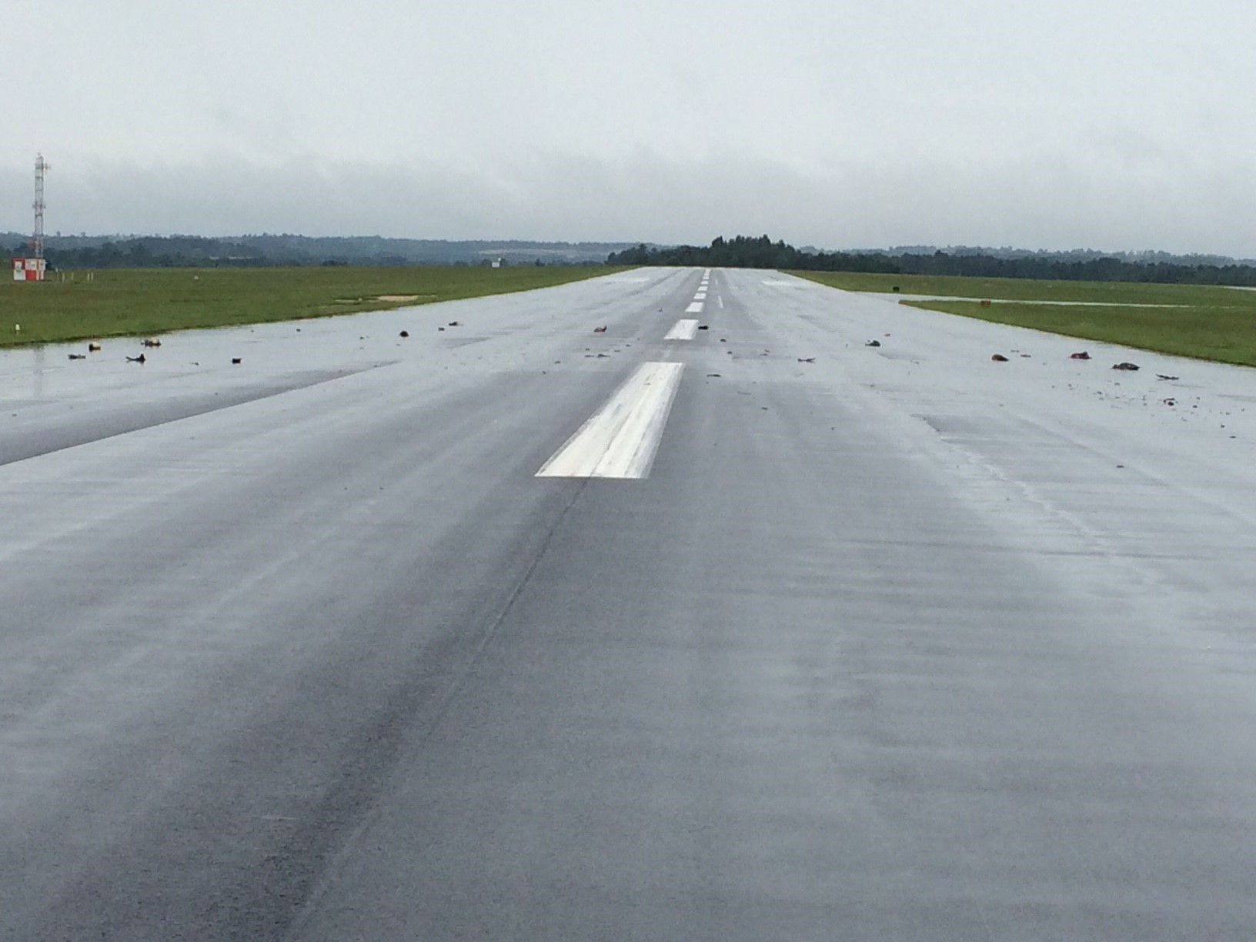

Slide 13
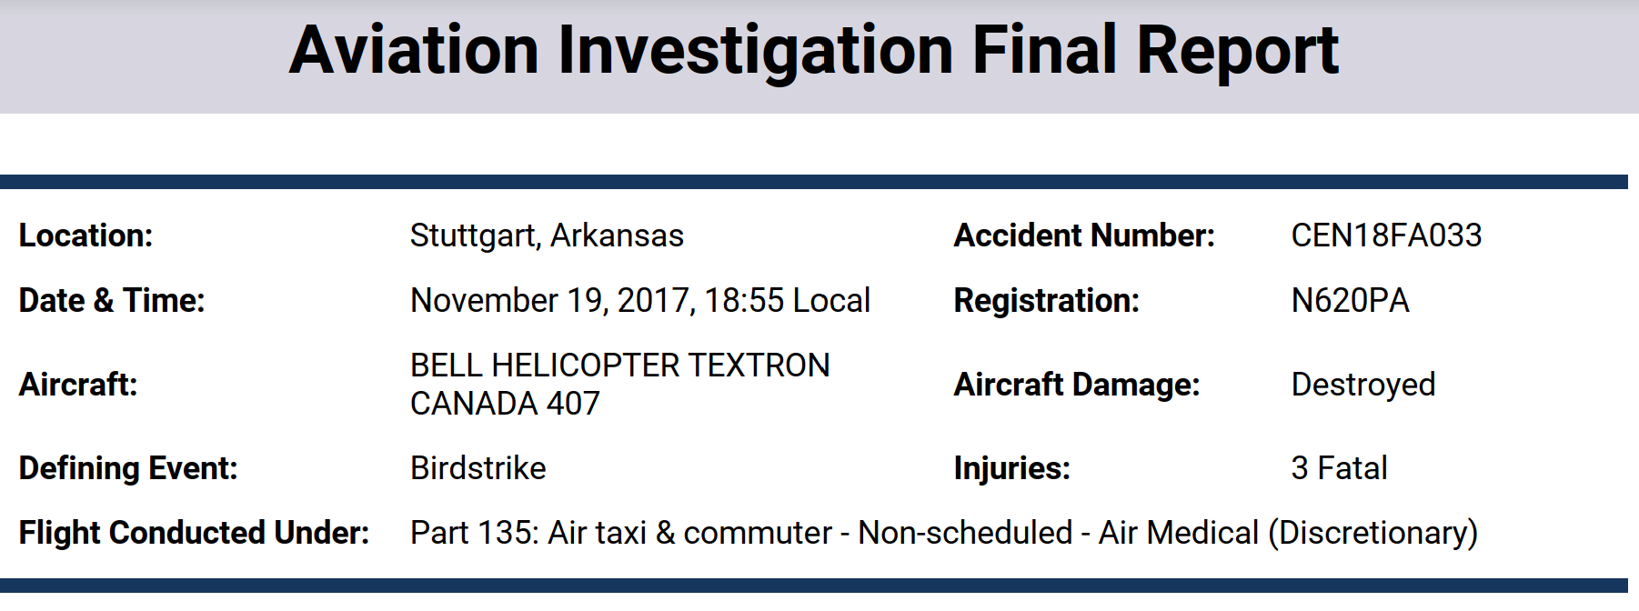
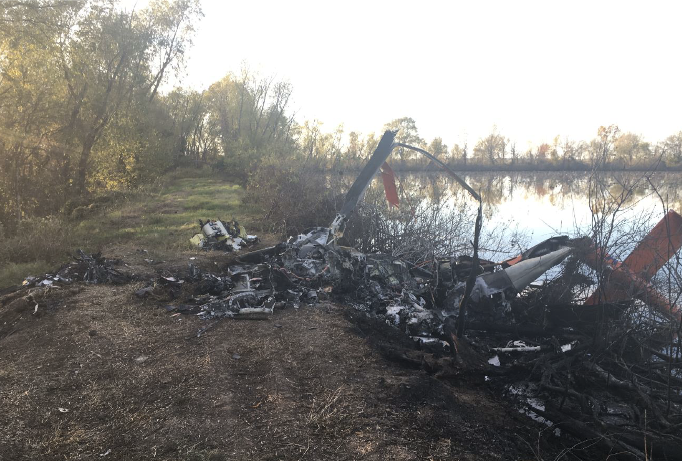
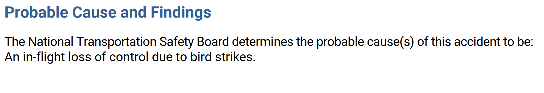
Fatal Accident

Slide 14
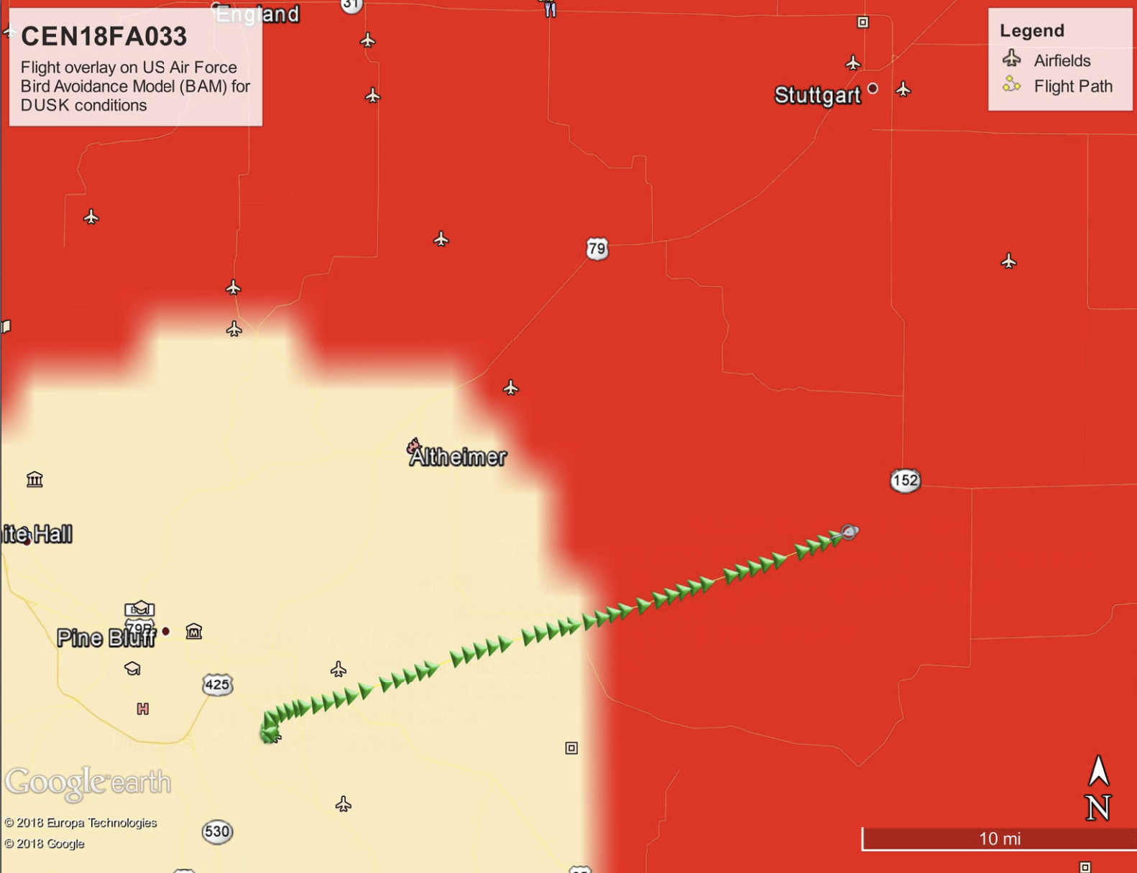
Fatal Accident

Slide 15
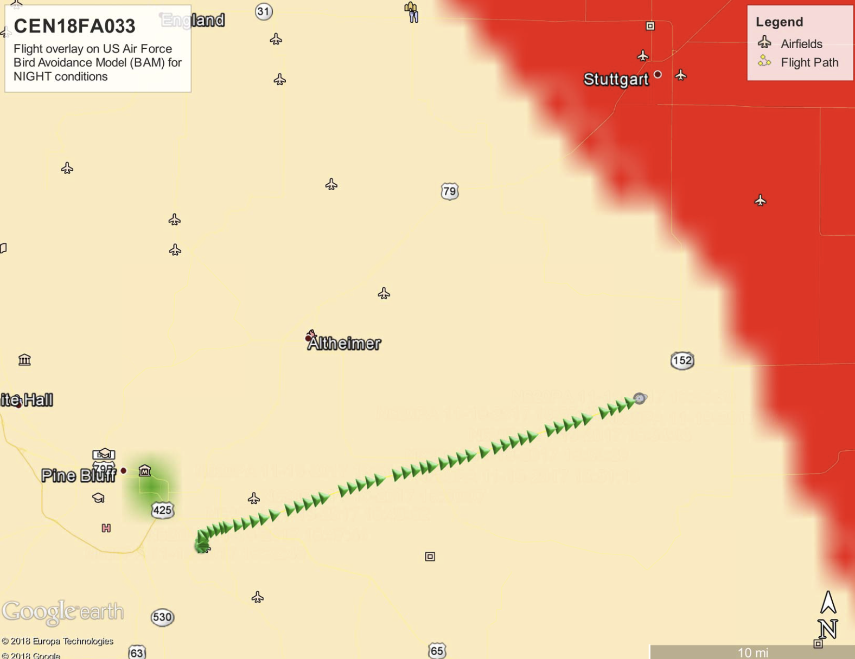
Fatal Accident

Slide 16
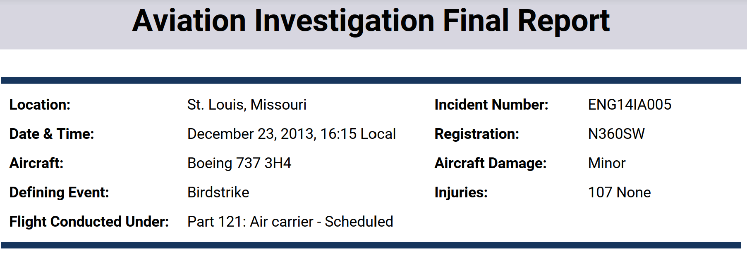
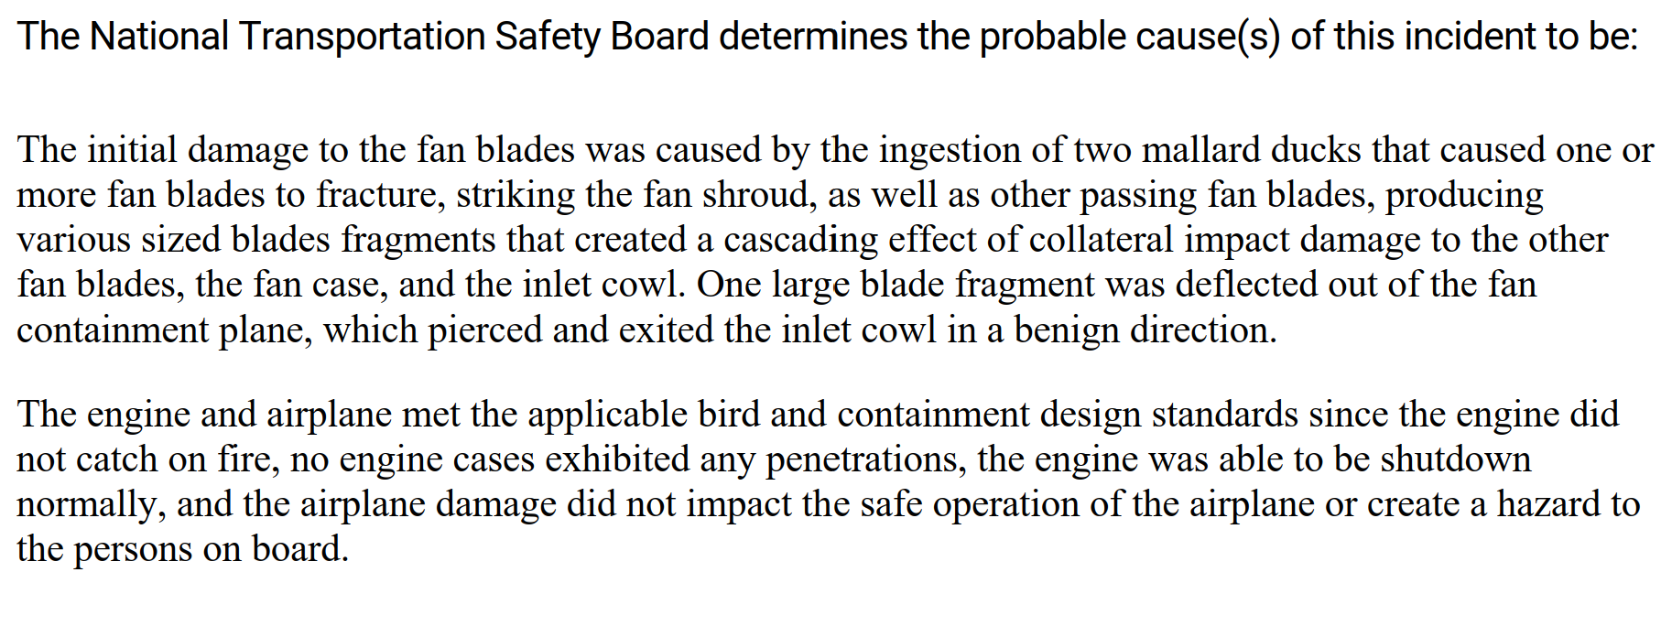
STL Airline Incident

Slide 17
Resources
Report a bird strike: https://wildlife.faa.gov/home
Study bird activity: https://www.usahas.com
Bird strike committee: https://birdstrike.org/
Airport Hazard Management YouTube Playlist: https://youtube.com/playlist?list=PLF1BE3AC34367E99E&si=tyYieqlr9qiPEeVC

Slide 18
USAHAS
Avian Hazard Advisory System
 | Probability
Severity (z) | 20 | 40 | 60 | 80 | 100
3 | 60 | 120 | 180 | 240 | 300
10 | 200 | 400 | 600 | 800 | 1000
30 | 600 | 1200 | 1800 | 2400 | 3000
100 | 2000 | 4000 | 6000 | 8000 | 10000
300 | 6000 | 12000 | 18000 | 24000 | 30000

Slide 19
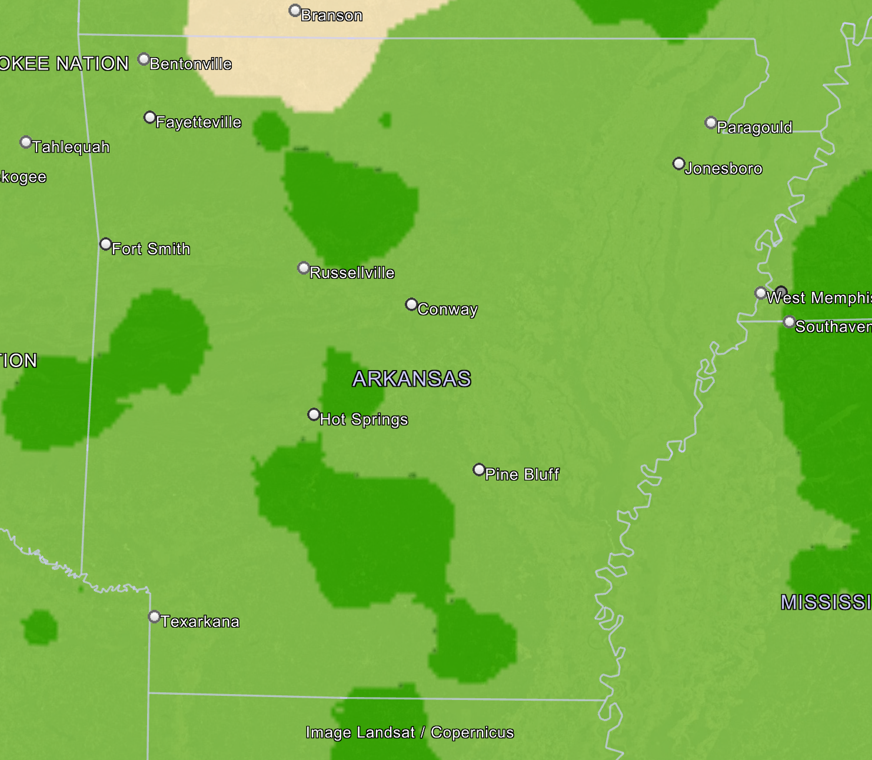
August

Slide 20
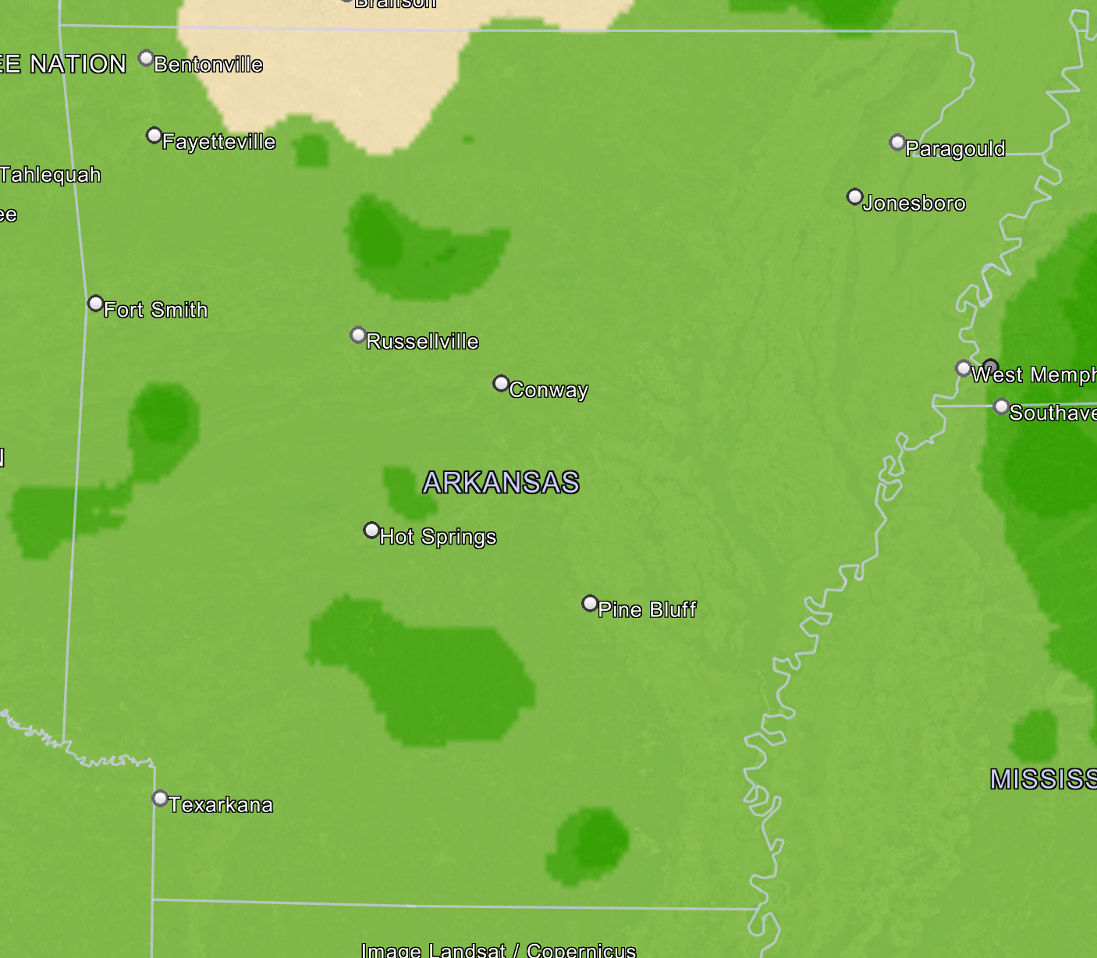
September

Slide 21
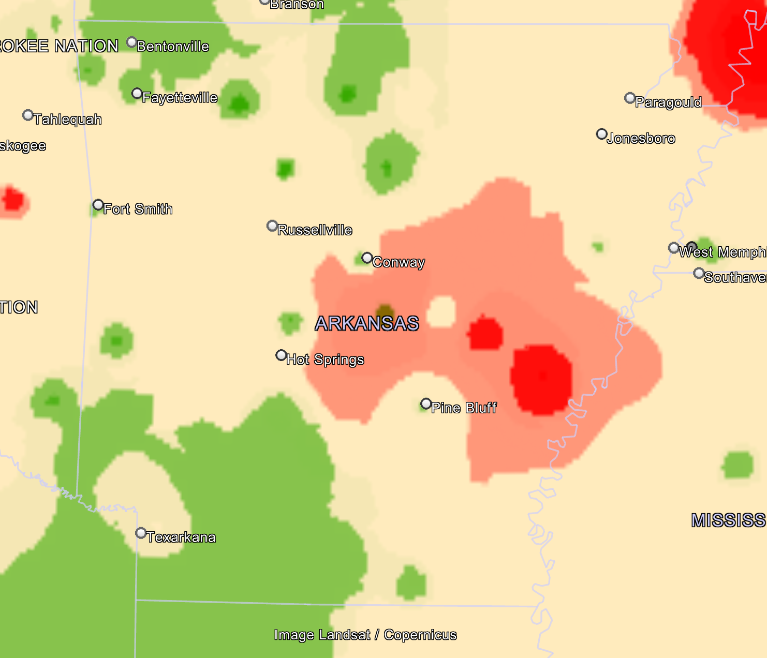
October

Slide 22
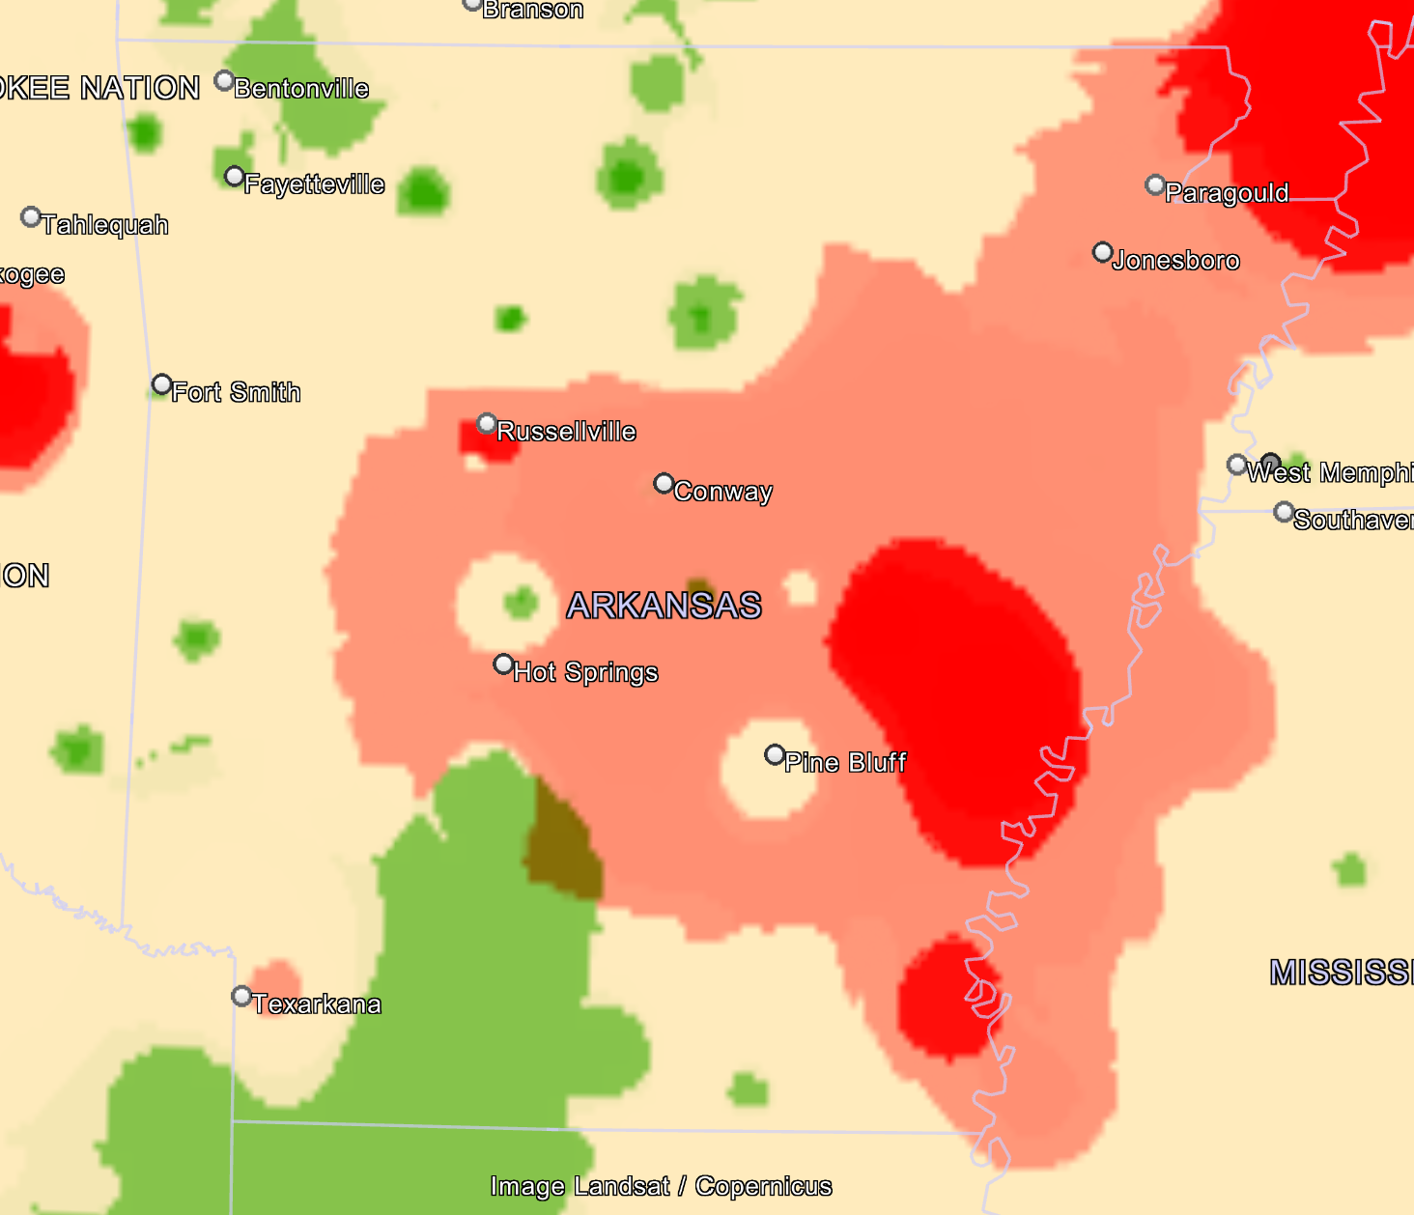
November

Slide 23
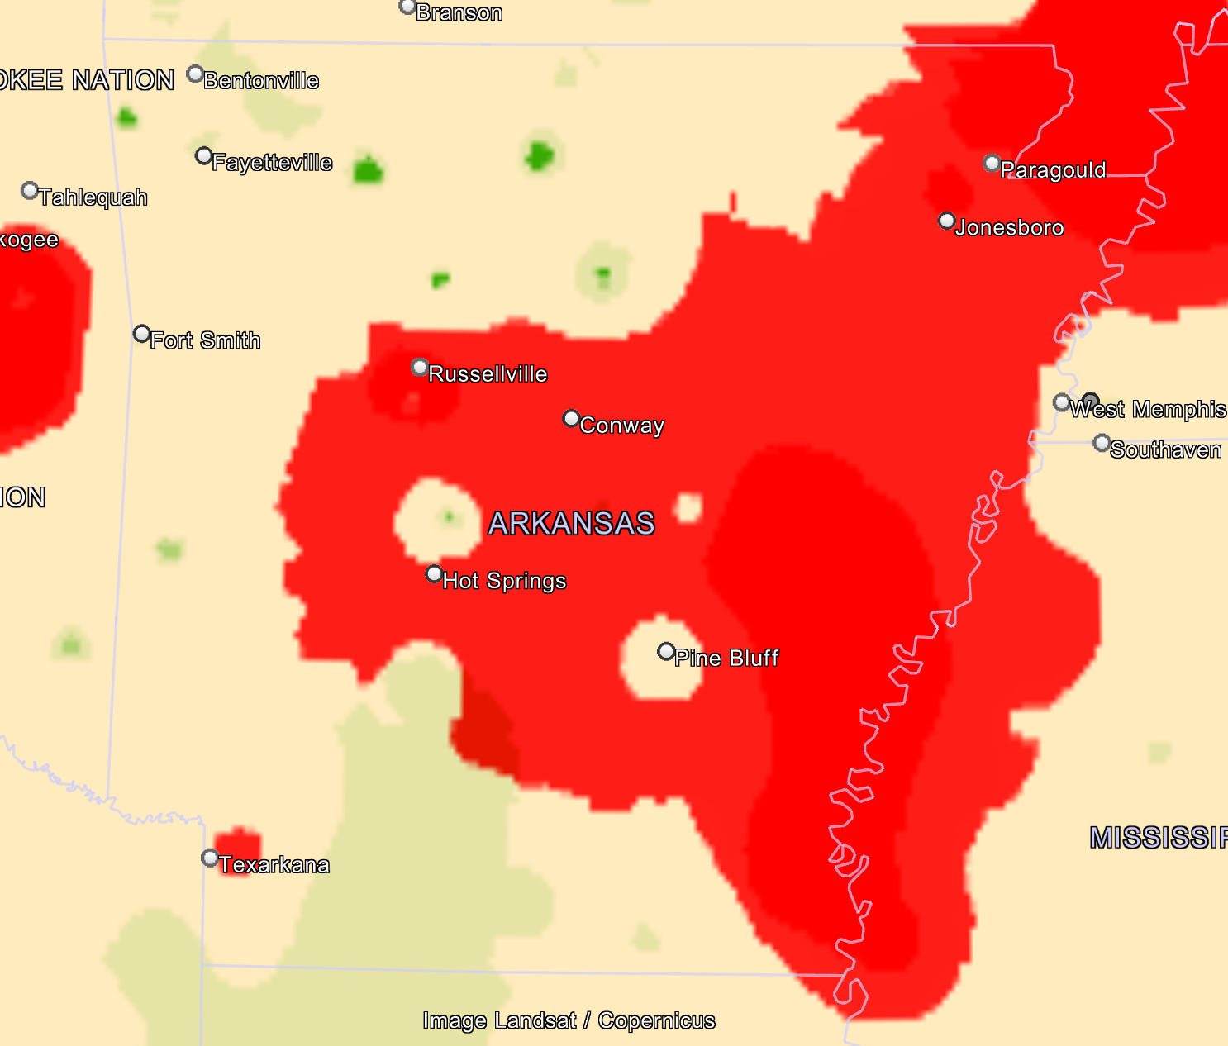
December

Slide 24
What if you hit a bird?
Maintain aircraft control
Engine failure?
Windscreen shattered? – Distraction high
  Fly the airplane
  Reduce airspeed, if able (configure gear and flaps)
Declare an emergency
Controllability check
  Test approach speeds at altitude (if able)

Slide 25
Discussion

